Slide 1

Applications

Slide 2
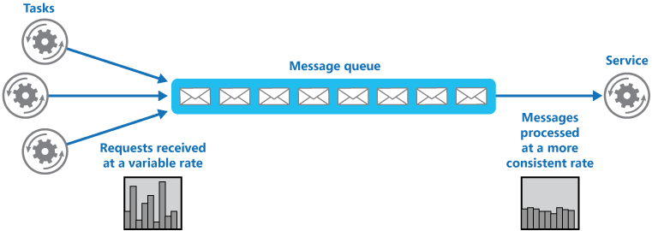
Applications Simple Queue Service (SQS)
Amazon Simple Queue Service (Amazon SQS) is a distributed message queuing service. It supports programmatic sending of messages via web service applications as a way to communicate over the Internet.
Queues are used to queue requests from users for further processing.
e.g. Uber users trying to book a cab, or travellers trying to book tickets
Two types of Queues
Standard Queues – messages are generally delivered in the same order they are sent
FIFO Queues – strictly the first message received are delivered first

Slide 3
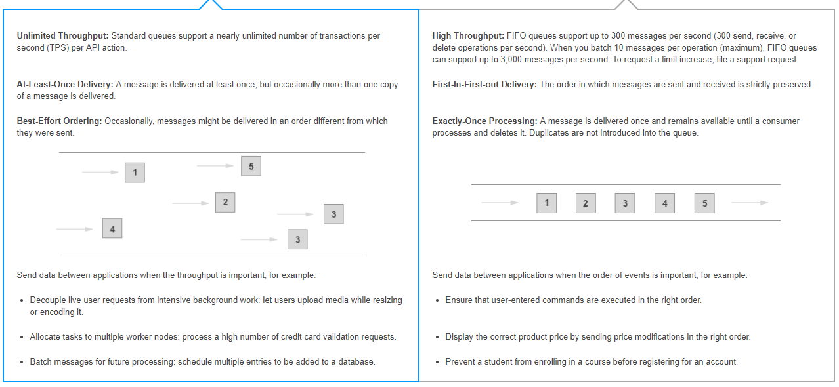
Applications Standards vs FIFO Queues

Slide 4
Applications SQS – Things to Remember
SQS is pull based and cannot push notifications, i.e. a separate service needs to poll it
Messages are 256 KB in size, size can be higher, however the message is store in S3 in that case
By default the messages are kept in queues for 4 days, can be changes from 1 minute to 14 days
SQS guarantees that the messages are delivered at least once

Slide 5
Applications Simple Workflow Services (SWF)
Amazon Simple Workflow Service (SWF) is a web service that makes it easy to coordinate work across distributed application components. Amazon SWF also provides the AWS Flow Framework to help developers use asynchronous programming in the development of their applications.
SWF has retention period of up to 14 days
Workflow executions can last upto 1 year
SWF is a task-oriented API, SQS is message-oriented
AWS ensures a task is assigned only once

Slide 6
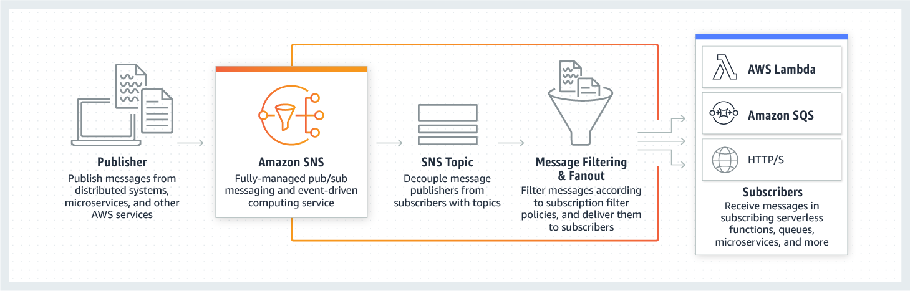
Applications Simple Notification Services (SNS)
Amazon Simple Notification Service (SNS) is a highly available, durable, secure, fully managed pub/sub messaging service that provides topics for high-throughput, push-based, many-to-many messaging.
It can deliver notifications to mobile devices via native push notification on both Android & iOS. It can also deliver notifications through SMS, email or HTTPS endpoint

Slide 7
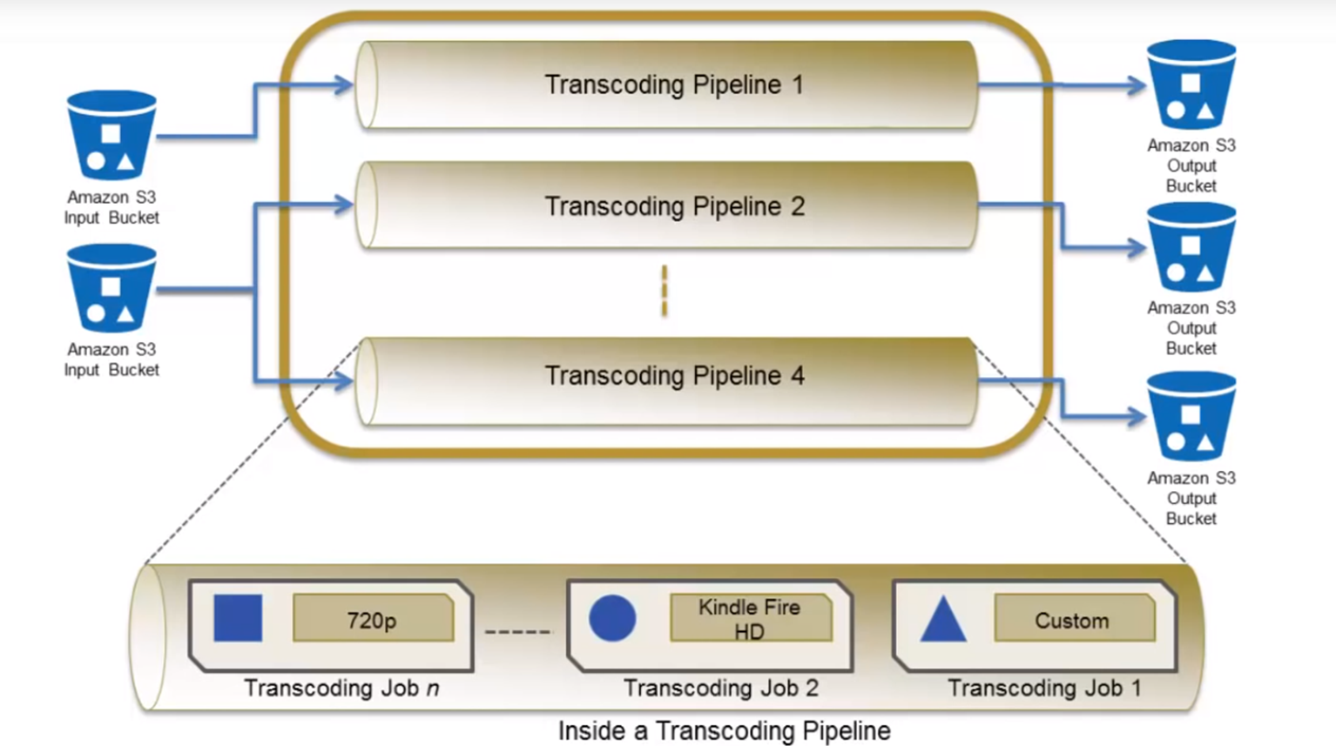
Applications Elastic Transcoder
Amazon Elastic Transcoder is media transcoding in the cloud to convert (or “transcode”) media files from their source format into versions that will playback on devices like smartphones, tablets and PCs.

Slide 8
Databases LAB - 1
Demo Elastic Transcoder
Notes:
#!/bin/bash
yum install httpd php php-mysql –y
cd /var/www/html
wget https://wordpress.org/latest.tar.gz
tar -xzf latest.tar.gz
cp -r wordpress/* /var/www/html/
rm -rf wordpress
rm -rf latest.tar.gz
chmod -R 755 wp-content
chown -R apache:apache wp-content
service httpd start
chkconfig httpd on

Slide 9
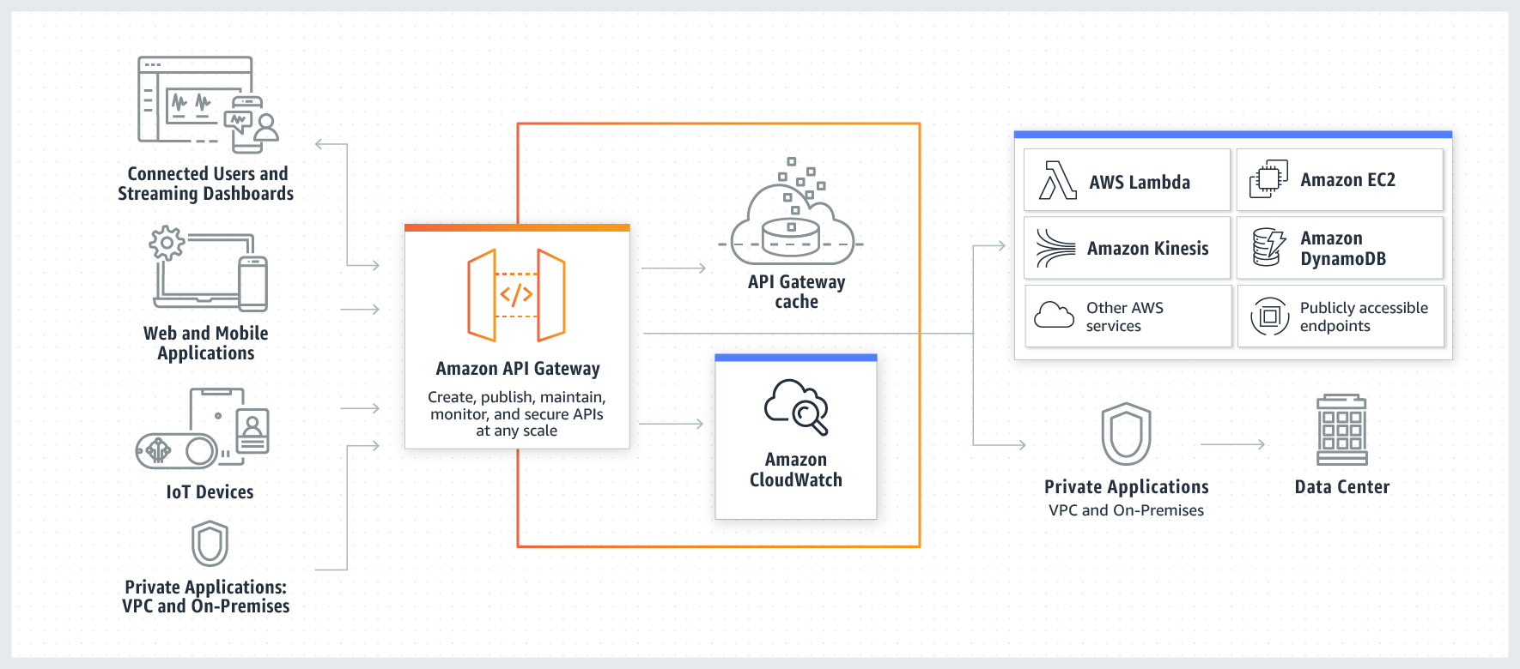
Applications API Gateway
Amazon API Gateway makes it easy to create, publish, maintain, monitor, and secure APIs at any scale.

Slide 10
Applications API Gateway
API Gateway can expose HTTPS endpoints to define RESTful API
Serverlessly connect to services like Lambda and DynamoDB
Send API endpoint to different targets
Easily scalable
Throttle request to prevent attach
Connect to CloudWatch to monitor the request
Caches common request with identical response to increase performance
Cross-origin resource sharing (CORS) allows to share multiple resources and bypass XSS

Slide 11
Applications LAB
Demo API Gateway
curl -X GET -H "Content-type: application/json" -H "Accept: application/json" https://3znf2qecq5.execute-api.ap-south-1.amazonaws.com/Test/pets

Slide 12
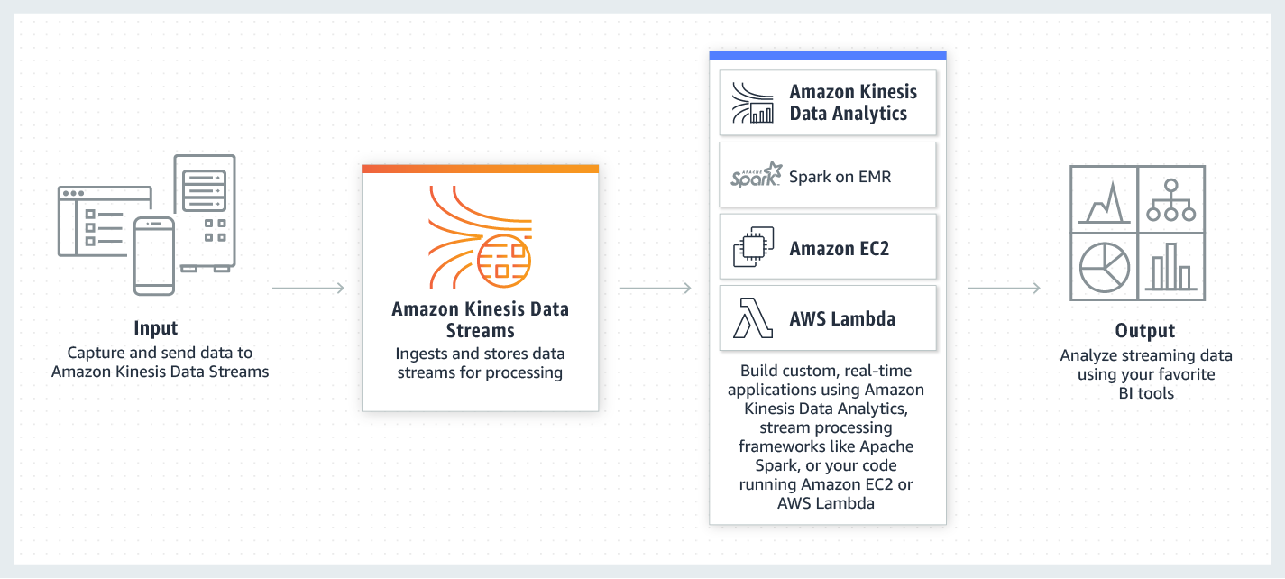
Applications Kinesis
Amazon Kinesis makes it easy to collect, process, and analyze real-time, streaming data.
With Amazon Kinesis, you can ingest real-time data such as video, audio, application logs, website clickstreams, and IoT telemetry data for machine learning, analytics, and other applications. Amazon Kinesis enables you to process and analyze data as it arrives and respond instantly instead of having to wait until all your data is collected before the processing can begin.

Slide 13
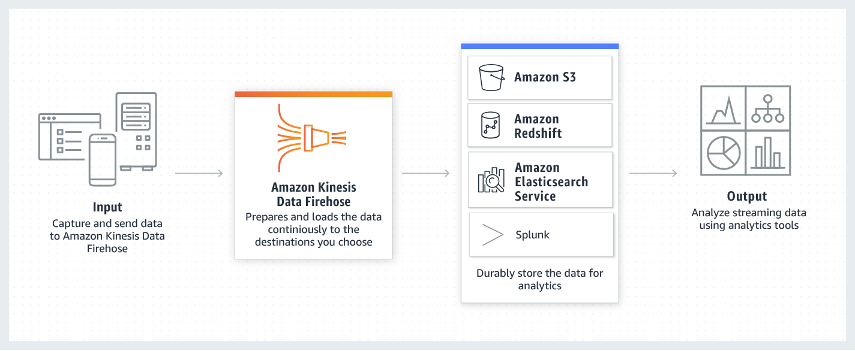
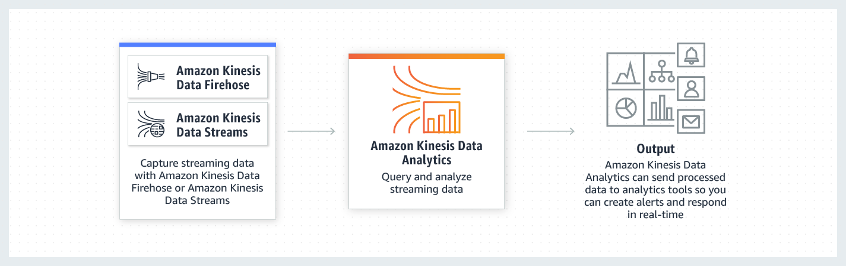
Applications Kinesis - Types
Kinesis Data Stream
Kinesis Firehose
Kinesis Analytics

